Slide 1
Clearing your CodeX

Slide 2
The need for clearing code
You will share the CodeX with other students.
Every time you run your program, it is loaded onto the CodeX
The last program executed stays on the CodeX
Therefore, you want the last program to be something that clears the CodeX and isn’t an assignment

Slide 3
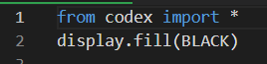
Create a file “Clear”
Create a new file in CodeSpace
  Name the file Clear
Type this code:
Run the code
  The CodeX should be blank, with no pictures or lights on
Run this code at the end of every class period

